Slide 1
Unsupervised learning
Unsupervised learning is a type of machine learning algorithm used to draw inferences from datasets consisting of input data without labeled responses.
The most common unsupervised learning method is cluster analysis, which is used for exploratory data analysis to find hidden patterns or grouping in data.

Slide 2
Types:
CLUSTERING
ASSCIATION RULE MINING
RECOMMENDER SYSTEMS
ANAMOLY DETECTION
DIMENSIONALITY REDUCTION

Slide 3
Clustering
Clustering is a Machine Learning technique that involves the grouping of data points.
Given a set of data points, we can use a clustering algorithm to classify each data point into a specific group
Notes:
https://towardsdatascience.com/the-5-clustering-algorithms-data-scientists-need-to-know-a36d136ef68?gi=857712a12d43#:~:text=Clustering%20is%20a%20Machine%20Learning,point%20into%20a%20specific%20group.

Slide 4
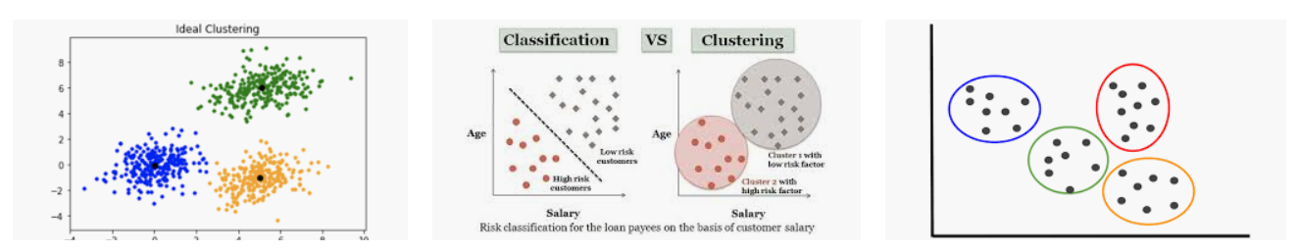
Notes:
1) Exclusive 2) Agglomerative 3) Overlapping 4) Probabilisti

Slide 5
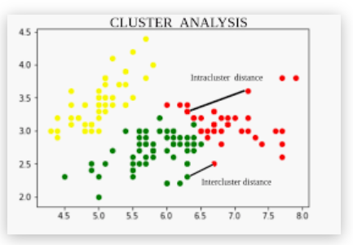
ALGO TYPES:
K-Means
K-Median
K-MEDIODS
MEAN SHIFT CLUSTERING [IMAGE SEGMENTATION]
HIERARICHAL CLUSTERING
TOP DOWN and BOTTOM UP
KNN clustering
Fuzzy Clustering
DBSCAN
Density-Based Spatial Clustering of Applications with Noise (DBSCAN)
EM using GMM
Expectation–Maximization (EM) Clustering using Gaussian Mixture Models (GMM)
Notes:
1) Exclusive 2) Agglomerative 3) Overlapping 4) Probabilistic
Centroid Linkage Distance : The centroid linkage distance is the distance between the centers vs and vt of two clusters S and T respectively, defined as – https://www.geeksforgeeks.org/ml-intercluster-and-intracluster-distance/
Centroid Diameter Distance : The centroid diameter distance is double average distance between all of the objects and the cluster center of s defined as –

Slide 6
Few other concepts
When it comes to clustering there are a few key terminologies which we encounter with. i.e.,
With-in-Sum-of-Squares (WSS): WSS is the total distance of data points from their respective cluster centroids
Total-Sum-of-Squares (TSS): TSS is the total distance of data points from global mean of data, for a given dataset this quantity is going to be constant
Between-Sum-of-Squares (BSS):
BSS is the total distance of various cluster centroids to the global mean of data
R²: R-Square is the total variance explained by the clustering exercise. i.e., BSS/ TSS
Higher the better
Notes:
1) Exclusive 2) Agglomerative 3) Overlapping 4) Probabilistic
Centroid Linkage Distance : The centroid linkage distance is the distance between the centers vs and vt of two clusters S and T respectively, defined as – https://www.geeksforgeeks.org/ml-intercluster-and-intracluster-distance/
Centroid Diameter Distance : The centroid diameter distance is double average distance between all of the objects and the cluster center of s defined as –
https://www.analyticsvidhya.com/blog/2019/08/comprehensive-guide-k-means-clustering/#:~:text=There%20is%20an%20algorithm%20that,a%20point%20to%20a%20cluster.

Slide 7
Association Rule Mining
as the name suggests, association rules are simple If/Then statements that help discover relationships between seemingly independent ITEMS.
Notes:
https://www.upgrad.com/blog/association-rule-mining-an-overview-and-its-applications/

Slide 8
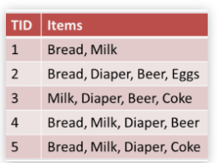
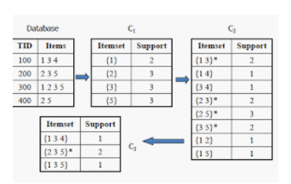
“If a customer buys bread, he’s 70% likely of buying milk.”
if there was no relation between beer and diapers
(that is, they were statistically independent),
then we would have got only 10% of diaper purchasers to buy beer too.
However, as surprising as it may seem, the figures tell us that 80% (=6000/7500) of the people who buy diapers also buy beer.

Slide 9
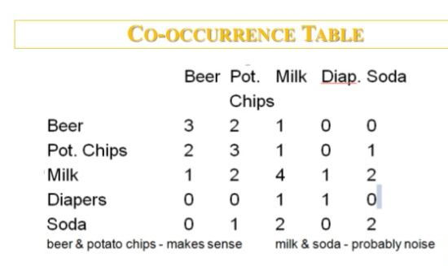
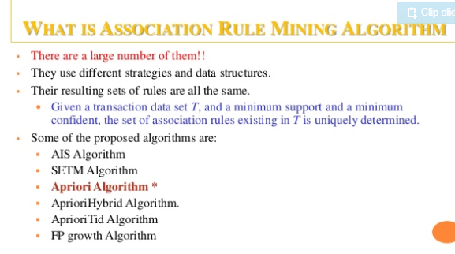
^{Market Basket Analysis:}
^{Medical Diagnosis:}
^{Census Data:}
^{Protein Sequence:}
Notes:
https://www.slideshare.net/hinafirdaus15/association-rule-mining-and-apriori-algorithm

Slide 10
Recommender systems
are an important class of machine learning algorithms that offer "relevant" suggestions to users.

Slide 11
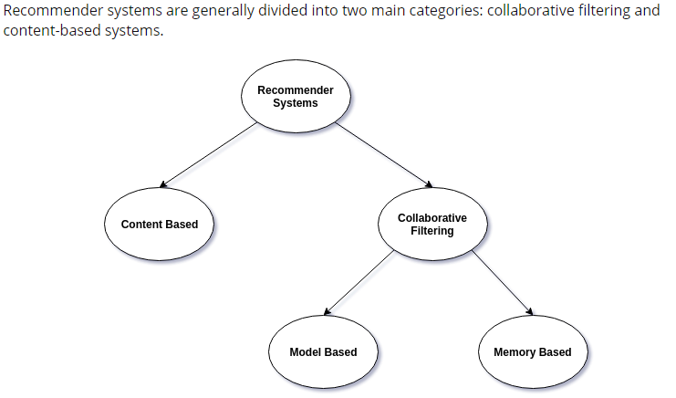
Categorized as either
content-based system
collaborative filtering

Slide 12
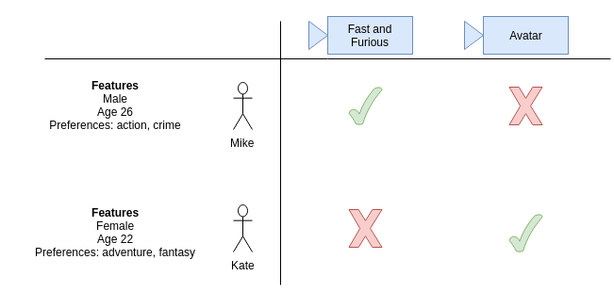
content-based system

Slide 13
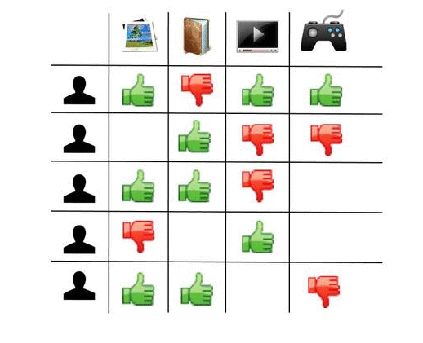
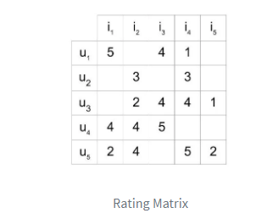
collaborative filtering
SPARSE MATRIX

Slide 14
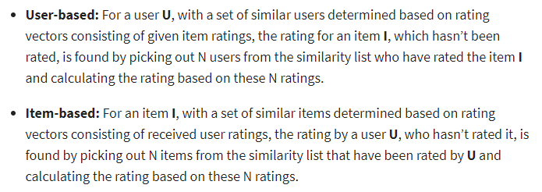
Memory Based
Notes:
Dimensionality Reduction
In the user-item matrix, there are two dimensions:
The number of users
The number of items
If the matrix is mostly empty, reducing dimensions can improve the performance of the algorithm in terms of both space and time. You can use various methods like matrix factorization or autoencoders to do this.

Slide 15
Model Based
Uses Dimensionality Reduction
In the user-item matrix, there are two dimensions:
1. The number of users
2. The number of items
If the matrix is mostly empty, reducing dimensions can improve the performance of the algorithm in terms of both space and time.
You can use various methods like:
Matrix factorization
Autoencoders

Slide 16
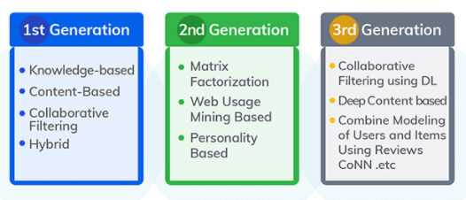
Notes:
Cooperative neural networks (CoNN)

Slide 17
DIMENSIONALITY REDUCTION
Dimensionality reduction, or dimension reduction, is the transformation of data from a high-dimensional space into a low-dimensional space so that the low-dimensional representation retains some meaningful properties of the original data, ideally close to its intrinsic dimension.
Feature ELIMINATION vs EXTRACTION
BIG DATA VisualizATion
EIGEN VECTORS and EIGEN VALUES

Slide 18
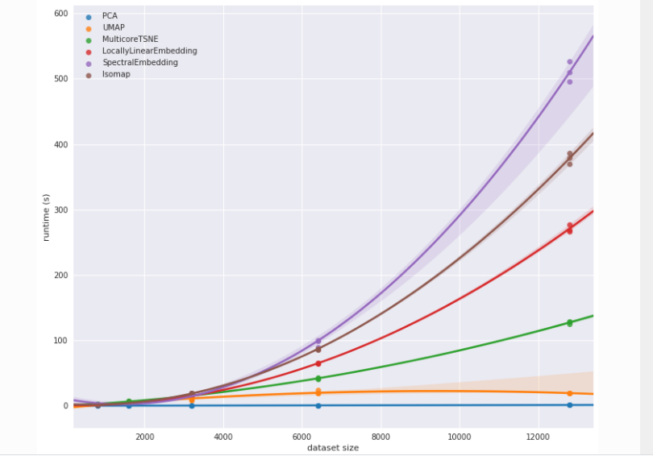
Current:
PCA
Future: --------------
T-SNE
ISOMAP
UMAP

Slide 19
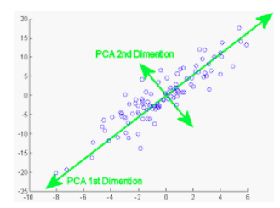
ALGOs
PCA
Principal component analysis is a technique for feature extraction
Because our principal components are orthogonal to one another, they are statistically linearly independent of one another… which is why our columns of Z* are linearly independent of one another!
Notes:
https://towardsdatascience.com/a-one-stop-shop-for-principal-component-analysis-5582fb7e0a9c
https://towardsdatascience.com/the-mathematics-behind-principal-component-analysis-fff2d7f4b643

Slide 20
Orthogonal: Uncorrelated to each other, i.e., correlation between any pair of variables is 0.
3 step process:::;
Covariance Matrix: This matrix consists of the covariances between the pairs of variables. The (i,j)th element is the covariance between i-th and j-th variable.
Eigen Values
DET ( C – ƛ I ) = 0
Eigenvectors: Eigenvectors and Eigenvalues are in itself a big domain, let’s restrict ourselves to the knowledge of the same which we would require here. So, consider a non-zero vector v. It is an eigenvector of a square matrix A, if Av is a scalar multiple of v. Or simply:
Av = ƛv
Cv = ƛv
Here ----- C is covariance matrix
Here, v is the eigenvector and ƛ is the eigenvalue associated with it.
Notes:
https://towardsdatascience.com/the-mathematics-behind-principal-component-analysis-fff2d7f4b643

Slide 21
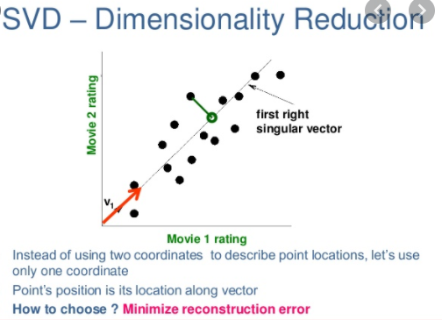
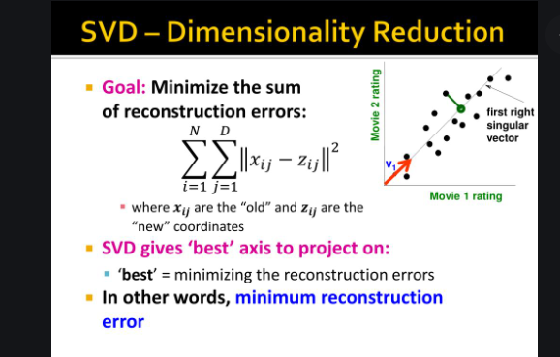
ALGOs
SVD – singular value decomposition
One of the features of SVD is that given the decomposition of M into U, S, and V, one can reconstruct the original matrix M, or an approximation of it.
Notes:
https://towardsdatascience.com/a-one-stop-shop-for-principal-component-analysis-5582fb7e0a9c

